Slide 1
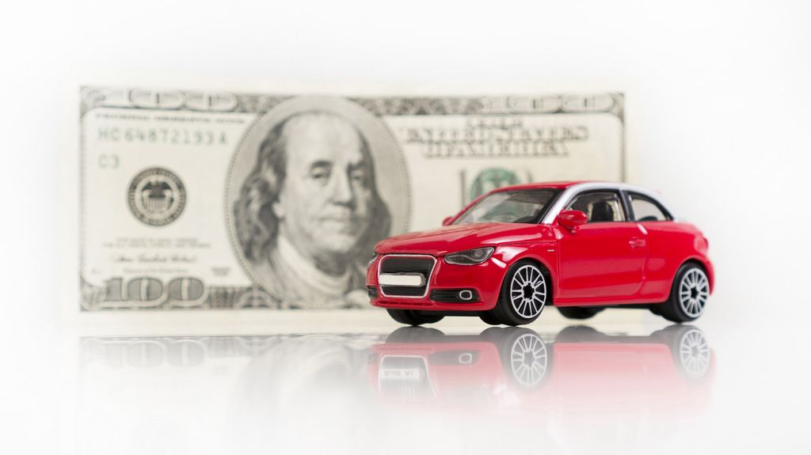
Used car Price Prediction
Presented By:
Junaid Shaikh

Slide 2
Introduction
With the covid 19 impact in the market, we have seen lot of changes in the car market. Now some cars are in demand hence making them costly and some are not in demand hence cheaper
The market value is based on a number of factors, including demand, supply, options, and incentives. The market value of a vehicle usually falls somewhere between the sticker price and the invoice price. Because the market value is an average, some people will pay more than that amount, while others will pay less
A car's value is determined by many factors: the popularity of the make and model of your car, vehicle specifications, trim levels, physical appearance, mileage, consistent maintenance and working condition

Slide 3
Analytical Problem Framing
In this analysis, we will be predicting the sale price of a used car in Indian market
Using this as a base, I have collected the data from few websites. The data was collected for the car body types like sedan, SUV/MUV, hatchback, minivan, coupe/convertibles
Once the data is collected, the data will be cleaned and pre-processed with all the necessary tools and the same will be used to build machine learning models in order to predict the price of the same

Slide 4
Data Collection Phase:
You have to scrape at least 5000 used cars data. You can scrape more data as well, it’s up to you. more the data better the model.
In this section You need to scrape the data of used cars from websites (Olx, cardekho, Cars24 etc.)
You need web scraping for this. You have to fetch data for different locations. The number of columns for data doesn’t have limit, it’s up to you and your creativity. Generally, these columns are
Brand, model, variant, manufacturing year, driven kilometers, fuel, number of owners, location and at last target variable Price of the car. This data is to give you a hint about important variables in used car model. You can make changes to it, you can add or you can remove some columns, it completely depends on the website from which you are fetching the data.
Try to include all types of cars in your data for example- SUV, Sedans, Coupe, minivan, Hatchback.

Slide 5
Data Analysis
The dataset has 9807 rows and 18 columns. Which after preprocess came down to 5556 rows and 11 columns. Using this dataset we will be training the Machine Learning models on 70% of the data and the models will be tested on 30% data.
Since we have removed the null values from the dataset during the data collection stage, we can expect outliers and un-realistic values for certain variables
I can see that there are few repeated data, which needs to be handled before we can proceed with further steps.

Slide 6
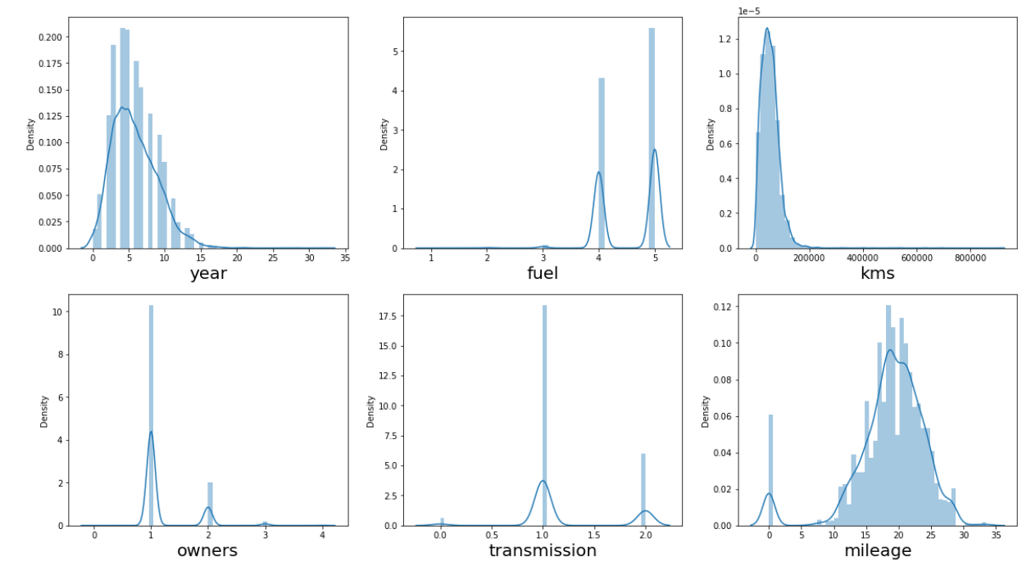
Exploratory Data Analysis Univariate Analysis Dist Plot

Slide 7
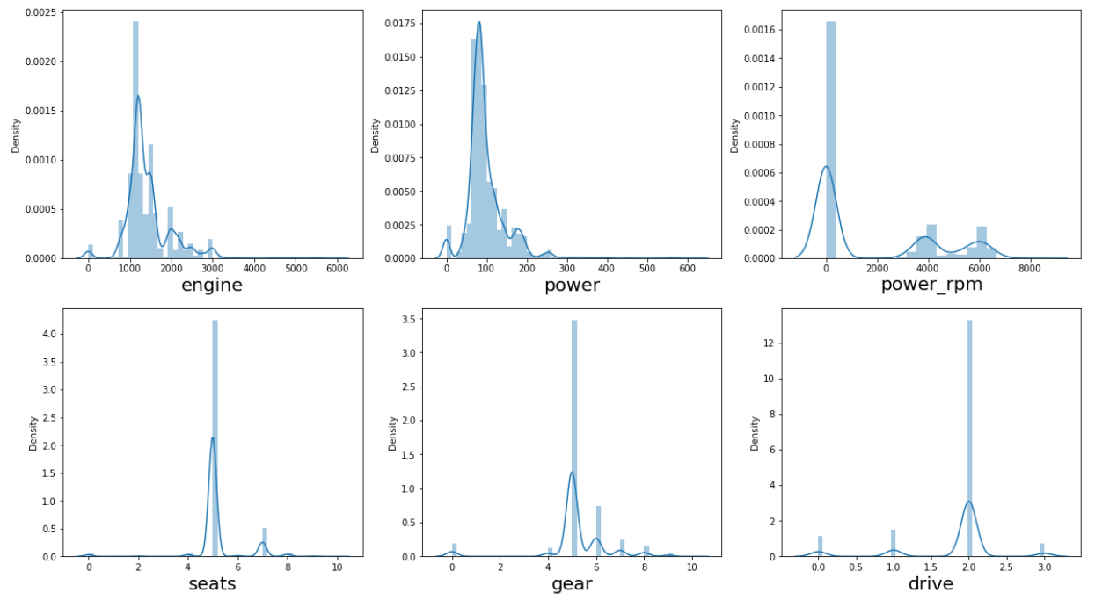
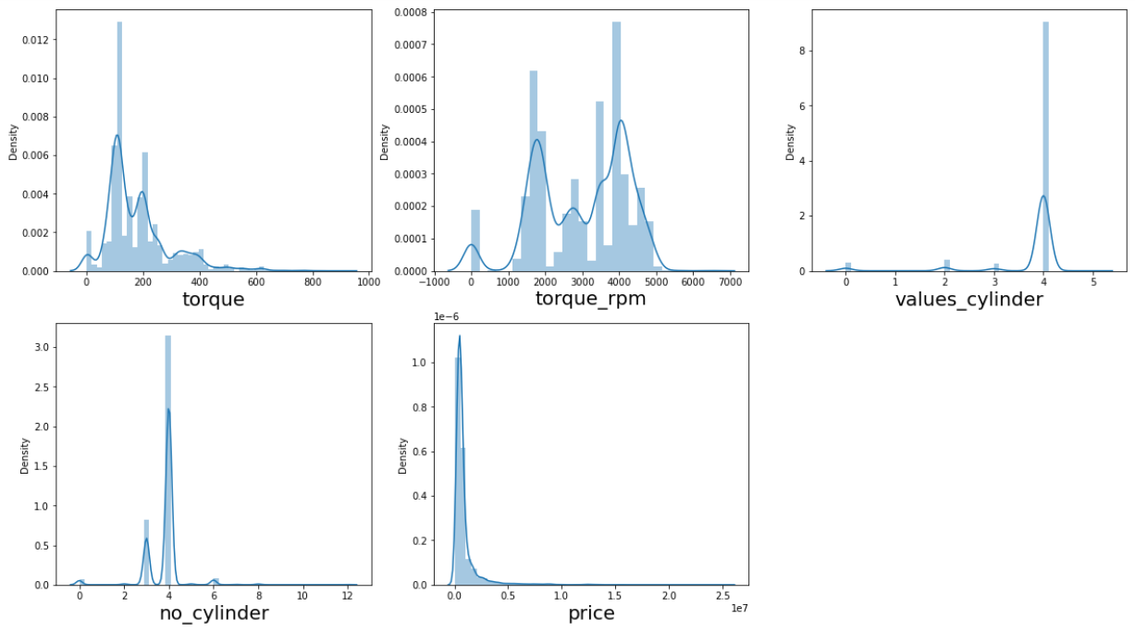
Observations:
kms column has normal distributed value points but it is highly skewed and contains outliers
mileage column has bimodal distributed value points with less skewness and less outliers
engine & power column has normal distributed value points but contain outliers
power_rpm column has bimodal distributed value points
torque & torque_rpm column has bimodal distributed value points with outliers

Slide 8
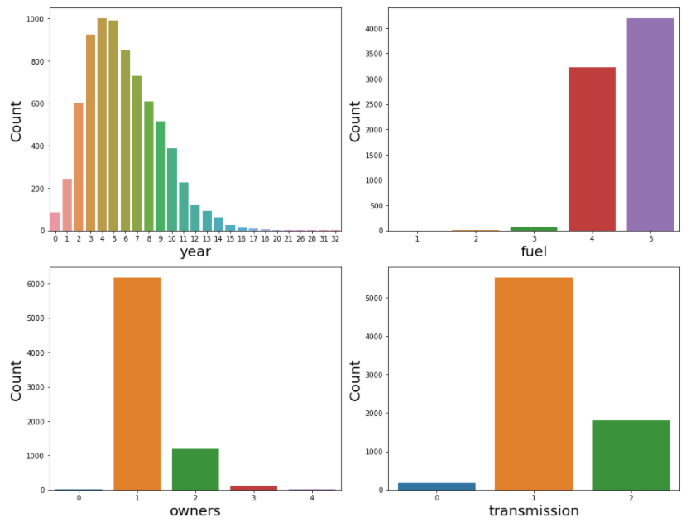
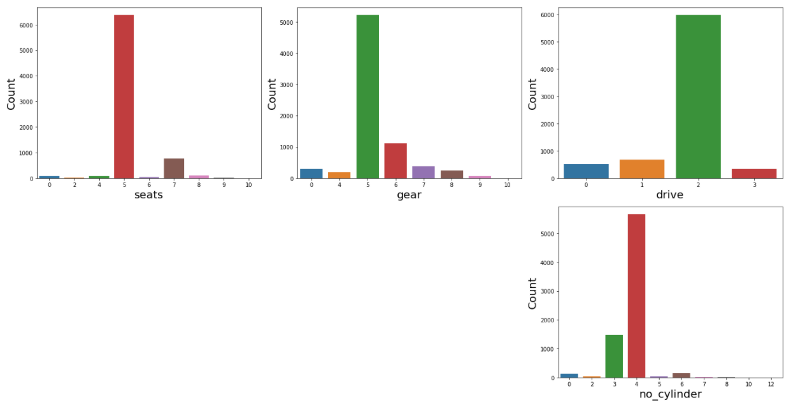
Count plot of all categorical column
Observation:
From the above graph we can observe the value_counts of datapoints of resp column
we can make a note about the data i.e., dataset contains data mostly of which year, transmision, range of gears of a car.........

Slide 9
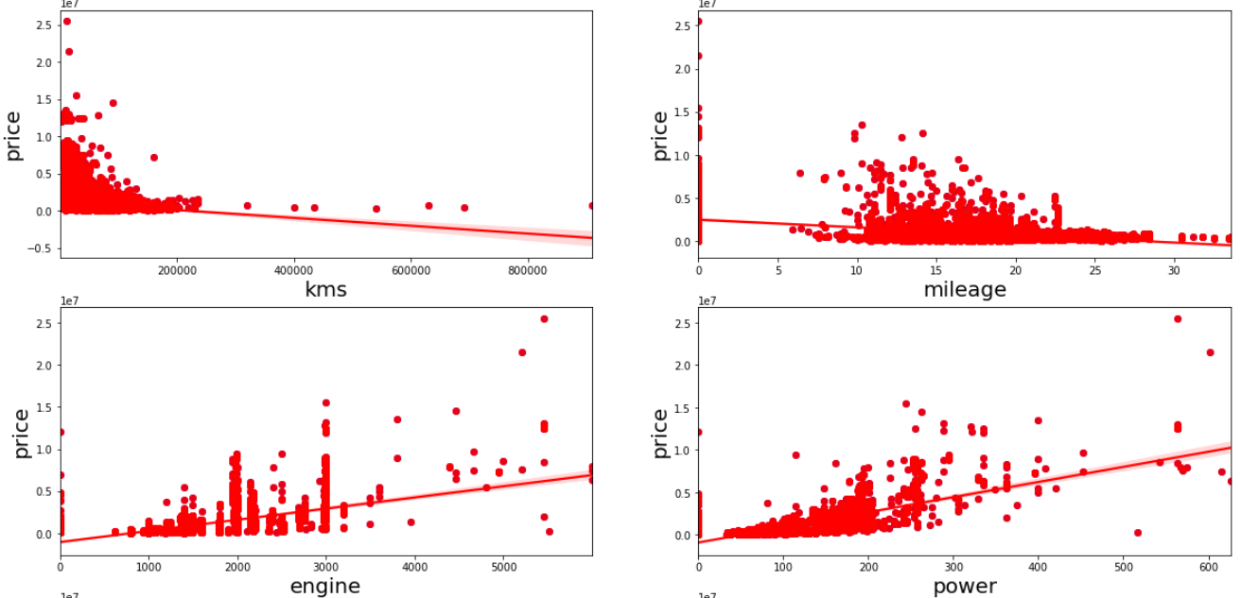
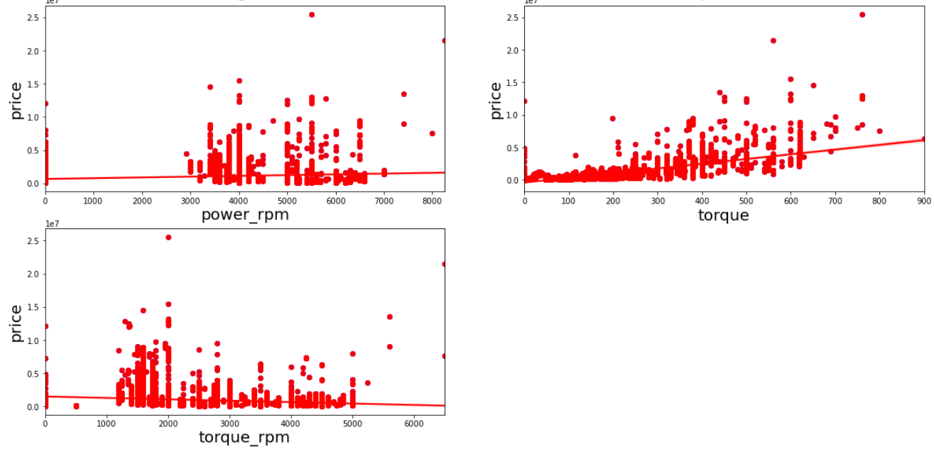
Bivariate analysis for numerical columns
Observation:
Columns having positive correlation with price are: torque, power, engine & power_rpm
Columns having negative correlation with price are: kms, mileage & torque_rpm

Slide 10
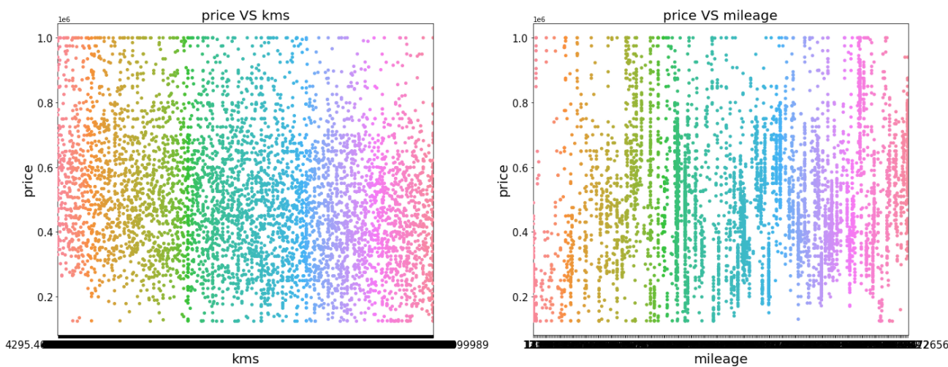
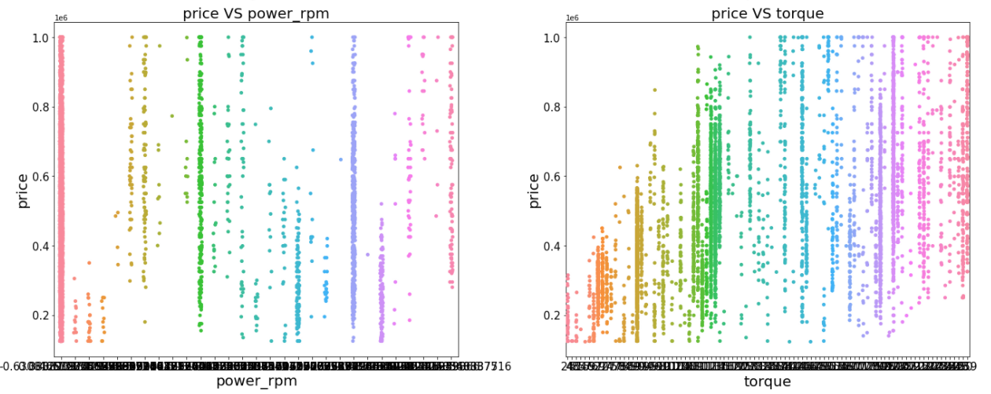
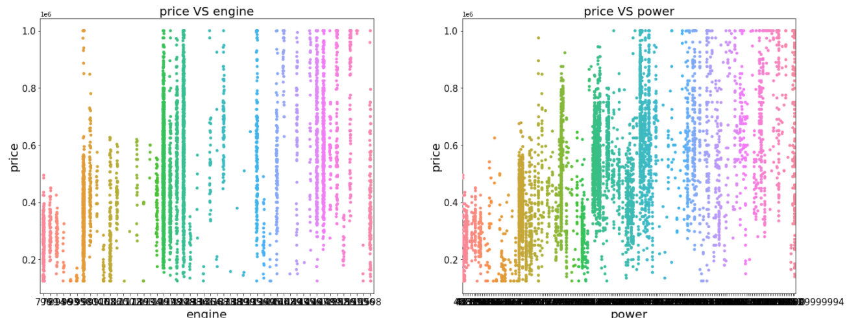
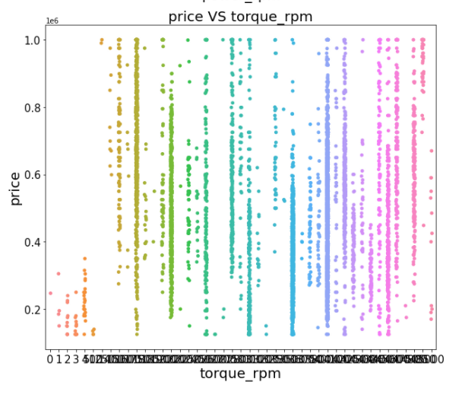
Strip Plot of each column values w.r.t label column
Observation:
for higher value of torque and higher value of engine, price rate of car is higher

Slide 11
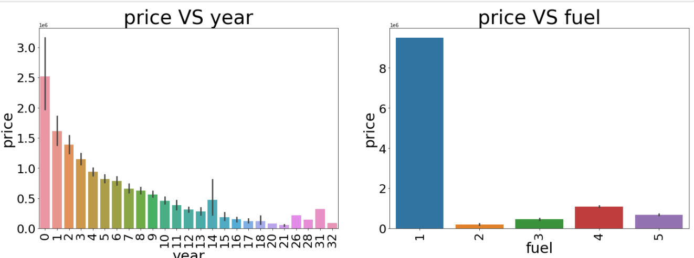
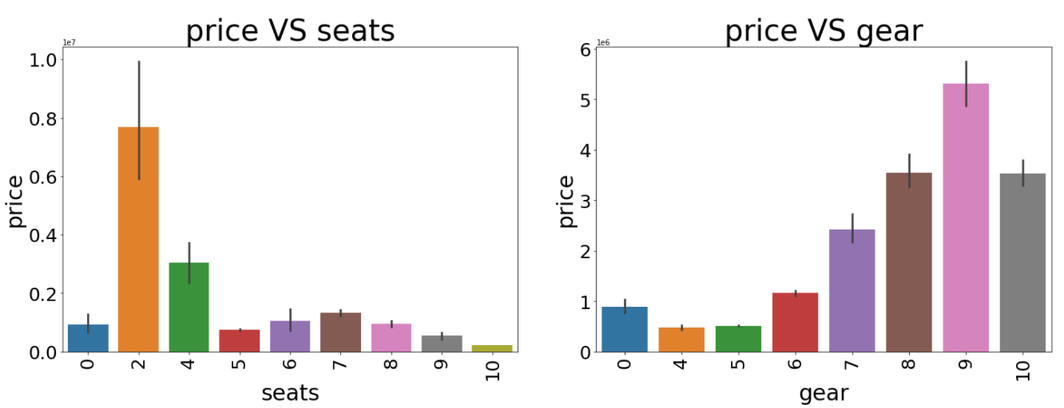
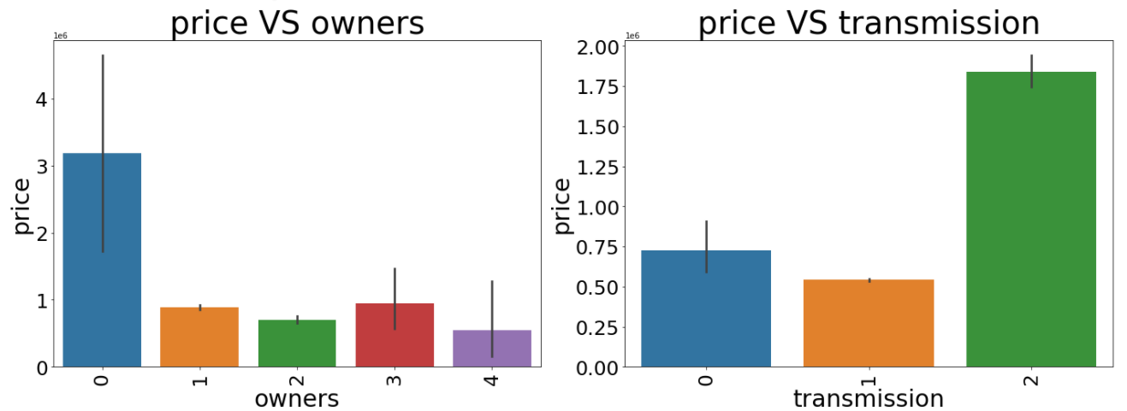
Bar graph for categorical column

Slide 12
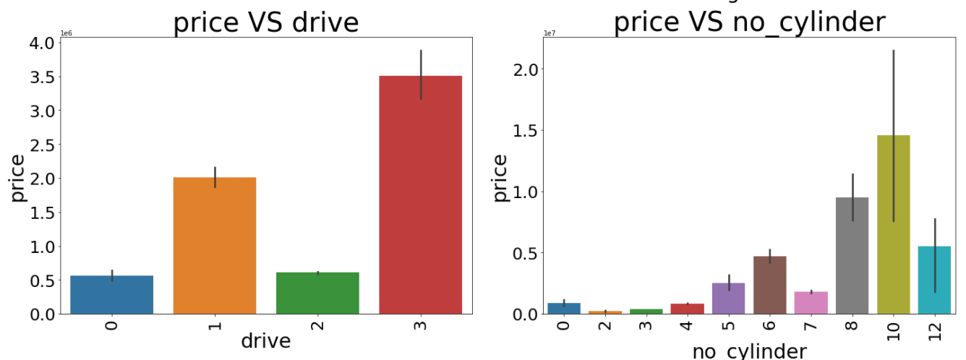
Observation:
newer models of car have higher sell price
cars having hybrid fuel type have higher sell price
unregistered cars have higher sell price
automatic transmission car have higher sell price
2 seater cars have highest sell price
cars with more number of gear have higher sell price
cars having all whell drive have higher sell price
higher the number of cylinder of an engine in a car has higher sell price

Slide 13
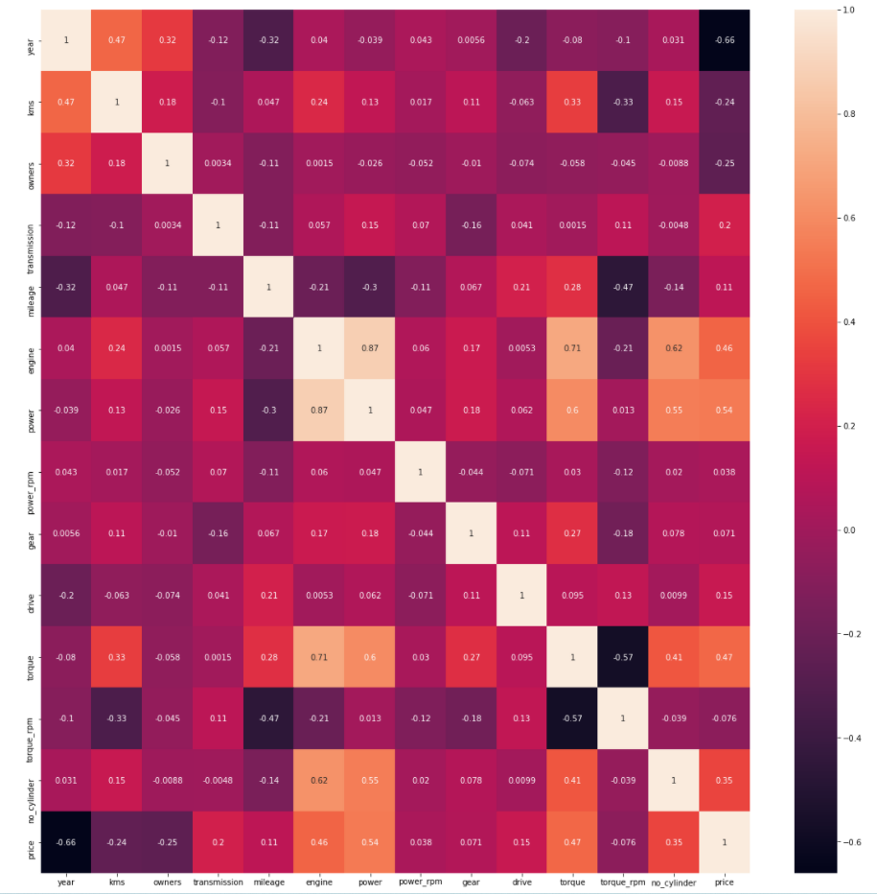
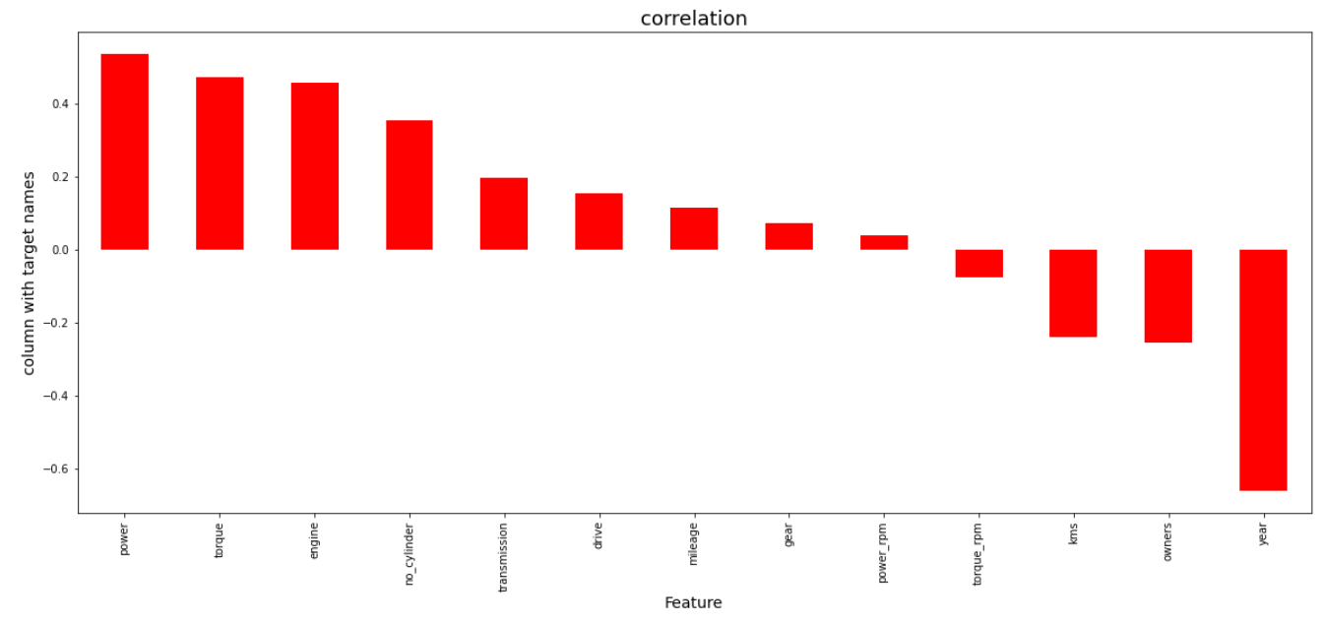
Check For Correlation
Observation:
We can analyze that column gear, power_rpm & torque_rpm have least correlation, but we will not drop them for now and analyze further

Slide 14
Data Pre-Process

Slide 15
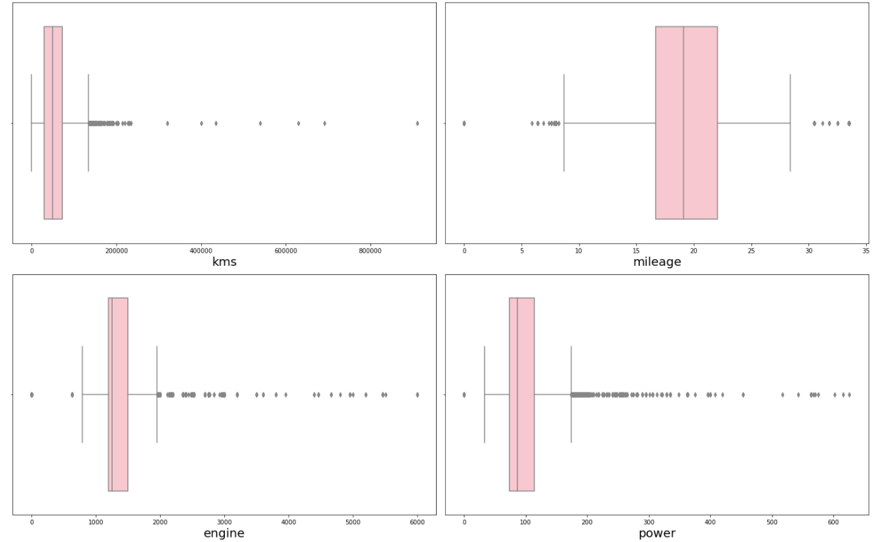
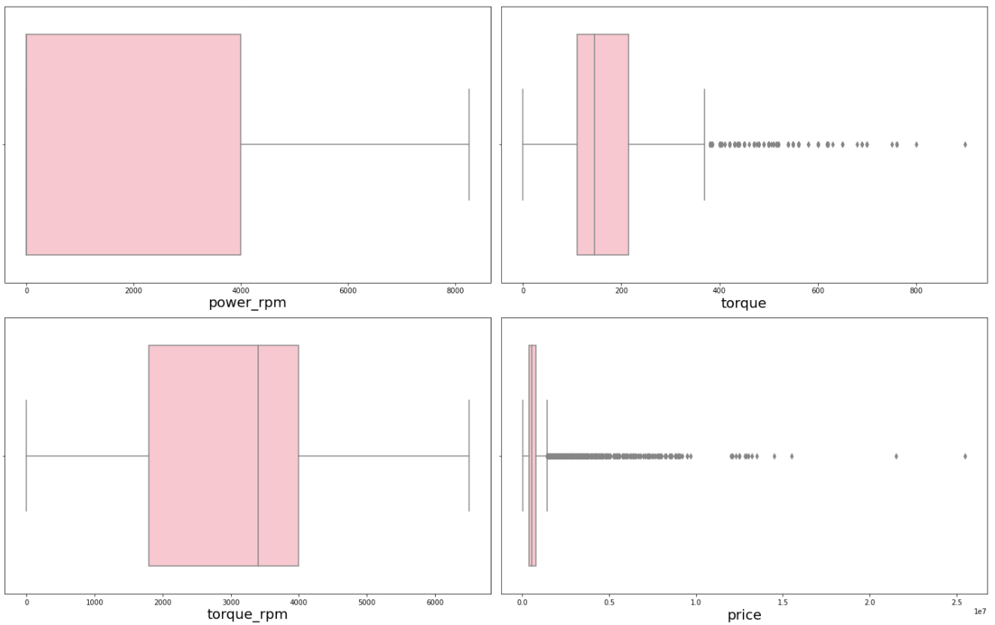
Outliers
Outliers are present in column kms, mileage, engine, power, torque & price, removed them using z-score & percentile method

Slide 16
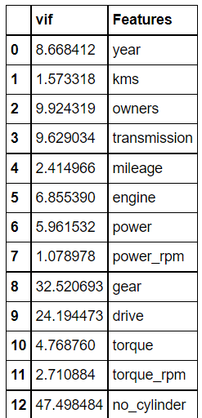
VIF to detect multicollinearity
Observation:
Drop column no_cylinder, drive, gear

Slide 17
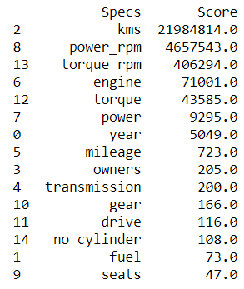
Best feature column
Drop column seats & fuel as they have least significance regarding target variable.

Slide 18
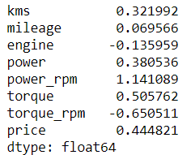
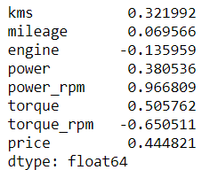
Skewness
Before Fixing Skewness
After Fixing Skewness

Slide 19
Model development & Evaluation
Top 3 Models are:
LGBM REGRESSOR: 88%-86% accuracy
XGB REGRESSOR: 88%-85% accuracy
RandomForest Regressor: 87% - 85% accuracy
Fine-Tune these models by using their best parameters obtained after executing GridSearchCV or RandomizedSearchCV.
Find the best random split for LGBM REGRESSOR model and use it to split the dataset into train and test dataset.

Slide 20
Model development & Evaluation
As we know from above output that our top models do not have accuracy above 96%, hence we will stack our top 3 models to build one model to obtain higher accuracy.
To stack models, we must use StackCVRegressor to combine all our fine tune models.
After using StackCVRegressor we obtain test accuracy of more than 88%.

Slide 21
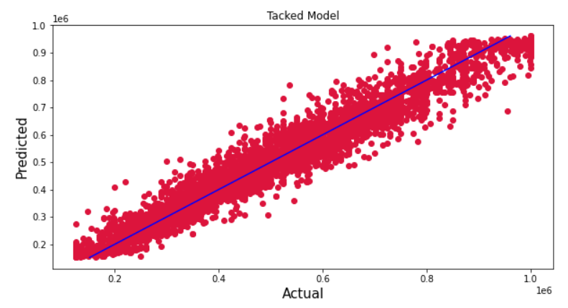
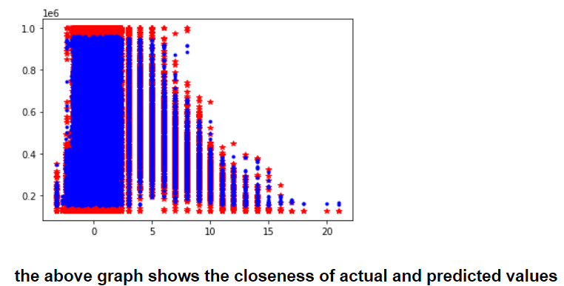
Results Display regression plot for actual datapoints vs predicted datapoints.

Slide 22
Conclusion
In this project we have tried to show how the house prices vary and what are the factors related to the changing of house prices. The best accuracy score was achieved by stacking our top 3 fine-tuned models.
Stacked Model was built having accuracy more than 90% using train dataset.

Slide 23
Limitation and scope for future work
While we couldn’t reach out goal of minimum RMSE in car price prediction without letting the model to overfit, we did end up creating a system that can with enough time and data get very close to that goal.
As with any project there is room for improvement here.
The very nature of this project allows for multiple algorithms to be integrated together as modules and their results can be combined to increase the accuracy of the final result.
This model can further be improved with the addition of more algorithms into it.
However, the output of these algorithms needs to be in the same format as the others.
Once that condition is satisfied, the modules are easy to add as done in the code.
This provides a great degree of modularity and versatility to the project.

